Slide 1
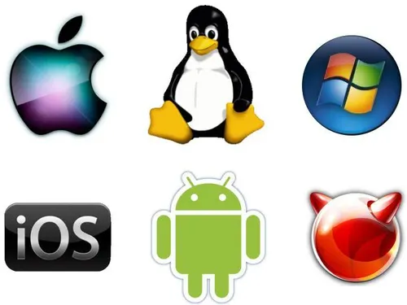
Introduction to Operating System
Chapter 1
Notes:
"In this chapter, we’ll explore what an Operating System is, its history, the different types of OS, and how we can install one using VirtualBox. This will help us understand the foundation of every computing system."

Slide 2
Learning Objectives
Define what an operating system is and explain its role in computing.
Describe the key functions and responsibilities of an OS.
Trace the historical evolution of operating systems from batch systems to modern cloud-based OS.
Identify and differentiate between various types of operating systems.
Demonstrate the basic steps of installing an operating system

Slide 3
What is an Operating System?
The OS is system software that acts as an interface between users and computer hardware.
It manages hardware, software resources, and provides services for application programs.
Notes:
Playing music
You press play in a music app.
The OS sends the audio data to the sound card driver.
The sound card converts it into sound you hear through speakers or headphones.
Browsing the internet
You type a website in a browser.
The OS handles the network drivers to send and receive data from the internet.
The browser displays the page for you to see.
When you click "Print" on your computer:
You (user) click a button in an app.
The OS takes that request and sends it to the printer driver.
The driver talks to the printer hardware to print the page.

Slide 4
How Operating System Work
The operating system works in three main ways:
Controls resources – Manages hardware components like CPU, memory, storage, and I/O devices.
Provides an interface – Offers a way for users and applications to interact with the computer (CLI or GUI).
Acts as a program manager – Loads programs into memory, schedules CPU time, manages process execution, handles multitasking, and ensures programs do not interfere with each other. It also terminates processes when they finish or when needed, freeing resources for other tasks.
Notes:
Acts as a program manager – Loads programs into memory, schedules CPU time, manages process execution, handles multitasking, and ensures programs do not interfere with each other. It also terminates processes when they finish or when needed, freeing resources for other tasks.

Slide 5
History and Evolution of OS
1940s-1950s
Early Beginnings
Programs were manually loaded and run, one at a time.
The first operating system was introduced in 1956. It was a batch processing system GM-NAA I/O (1956) that automated job handling
1960s
Multiprogramming and Timesharing
Introduction of multiprogramming to utilize CPU efficiently.
Timesharing systems, like CTSS (1961) and Multics (1969), allowed multiple users to interact with a single system
1970s
Unix and Personal Computers
Unix (1971) revolutionized OS design with simplicity, portability, and multitasking.
Personal computers emerged, leading to simpler OSs like CP/M (1974) and PC-DOS (1981).
1980s
GUI and Networking
Graphical User Interfaces (GUIs) gained popularity with systems like Apple Macintosh (1984) and Microsoft Windows (1985).
Networking features, like TCP/IP in Unix, became essential.
1990s
Linux and Advanced GUIs
Linux (1991) introduced open-source development.
Windows and Mac OS refined GUIs and gained widespread adoption.
2000s-Present
Mobility and Cloud
Mobile OSs like iOS (2007) and Android (2008) dominate.
Cloud-based and virtualization technologies reshape computing, with OSs like Windows Server and Linux driving innovation
Notes:
1940s–1950s – Computers ran one program at a time. The first OS appeared in 1956 to help automate tasks.
1960s – Multiprogramming let computers run multiple programs at once. Timesharing let many users share one computer.
1970s – Unix made OS simpler and portable. Personal computers became popular.
1980s – Graphical interfaces (like Windows and Mac) and networking became common.
1990s – Linux brought open-source OS. Windows and Mac improved GUIs and spread widely.
2000s–Present – Mobile OS (iOS, Android) dominate. Cloud and virtualization changed how computers are used.
https://www.geeksforgeeks.org/operating-systems/evolution-of-operating-system/

Slide 6
Types of Operating Systems
Server OS
Mobile OS
Client OS

Slide 7
Server Operating System
-A server Operating System that is built to manage largescale resources and serve multiple users at the same time. These OSs are tuned for serving web pages. Databases or managing networks.
Notes:
A server operating system is special software that runs on a server to manage its hardware, software, and network so it can serve many users at the same time.
Main jobs:
Accept requests from clients (computers, phones, apps) over a network.
Run services like websites, file sharing, databases, or email.
Manage server hardware (CPU, memory, storage, network).
Provide security, backups, and remote access.
Keep running 24/7 for constant availability.

Slide 8
Key Features of Server Operating System
Network and hardware management
High reliability & uptime to support critical applications.
Command-line interfaces (CLI) for efficient IT management
Examples: Ubuntu Server, Windows Server, Oracle Solaris and Red hat.

Slide 9
Client Operating System
-We use this type of operating system on personal devices such as desktops, laptops, etc. This Operating system are user-friendly and concentrate on providing a smooth computing experience.

Slide 10
Key Features of Client Operating System
Graphical user interface (GUI) for user friendliness
Compatible with multimedia, productivity and gaming.
Design for single user.
Examples: Windows, Kali Linux, Mac OS

Slide 11
Mobile Operating System
-these are types of operating system that are specially for smartphones, tablet ands other mobile devices. These Oss are tailored for touch interfaces, high performance, and energy efficiency to maximize battery life

Slide 12
Key Features of Mobile Operating System
Touch UI and application stores to download applications
Designed for lightweight applications and portability
Integration with mobile hardware(GPS, cameras, sensors, etc.).
Examples: Android, iOS, HarmonyOS

Slide 13
Overview Functions of an Operating System
Functions | Description
Process Management | Managing active programs
File Management | Organizing and accessing files
Command Interpreter | Enabling user interaction through commands
System Calls | Allowing communication between user applications and the OS
Signals | Handling system notification and Interruptions.
Network Management | Managing network connections.
Security Management | Protecting resources from unauthorized access.
I/O Device Management | Coordinating Interactions with input and output devices.
Secondary Storage Management | Managing long-term data storage.
Main Memory Management | Allocating and optimizing the use of RAM
Notes:
Process Management
Manages running programs (called processes), ensuring the CPU handles them properly and efficiently. Example: When you open a browser and a music player, the OS switches between them so both run smoothly.
2. File Management
Organizes files and folders, and controls how they are stored, named, and accessed. Example: When you save or open a document, the OS helps find and manage that file.
3. Command Interpreter
Lets users interact with the system by typing commands or clicking icons. Example: Using Command Prompt or Terminal to run commands like dir or ls.
4. System Calls
Provides a way for programs to ask the OS to perform tasks like reading files or using memory. Example: A game asks the OS to save progress—this request is done through a system call.
5. Signals
Sends notifications or warnings to processes when something needs attention, like errors or interruptions. Example: If a program crashes, the OS sends it a signal to stop.
6. Network Management
Manages internet and network connections, including sharing data between devices. Example: Connecting to Wi-Fi or sharing files over a network.
7. Security Management
Protects the system and data from unauthorized access or attacks. Example: Asking for a password before installing software.
8. I/O Device Management
Controls how the computer works with input (like keyboard and mouse) and output (like monitor and printer) devices. Example: Letting you print a document or type on your keyboard.
9. Secondary Storage Management
Handles hard drives or SSDs where data is stored long-term. Example: Saving movies or photos on your disk drive.
10. Main Memory Management
Manages RAM (temporary memory) so programs can run smoothly without interfering with each other. Example: When you open multiple apps, the OS decides how much memory each one gets.

Slide 14
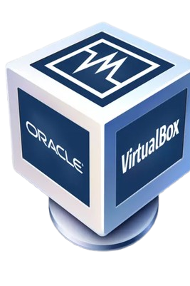
Installing OS using VirtualBox
What is VirtualBox?
A virtualization tool that allows running multiple OS on one machine.
Requirements:
• ISO file of OS
• Sufficient RAM and disk space

Slide 15
Steps in Installing an OS via VirtualBox
• Download and install VirtualBox
• Create a new virtual machine
• Allocate RAM and storage
• Attach the ISO file
• Start the VM and follow OS installation steps

Slide 16
Benefits of Using Virtual Machines
• Test multiple OS without needing extra hardware
• Safer environment for software testing
• Portable and easy to reset

Slide 17
Let’s get hands on open your pc.

